Slide 1

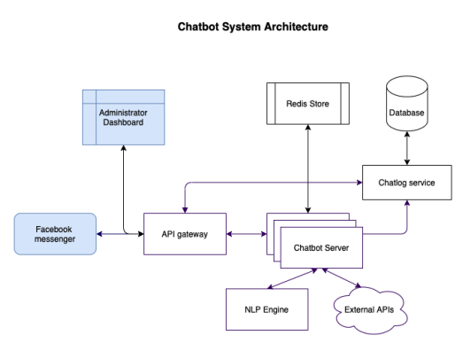
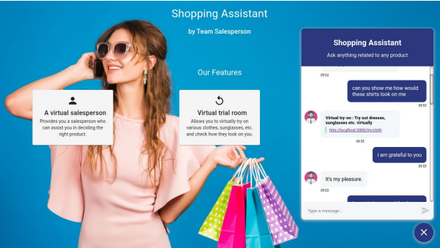
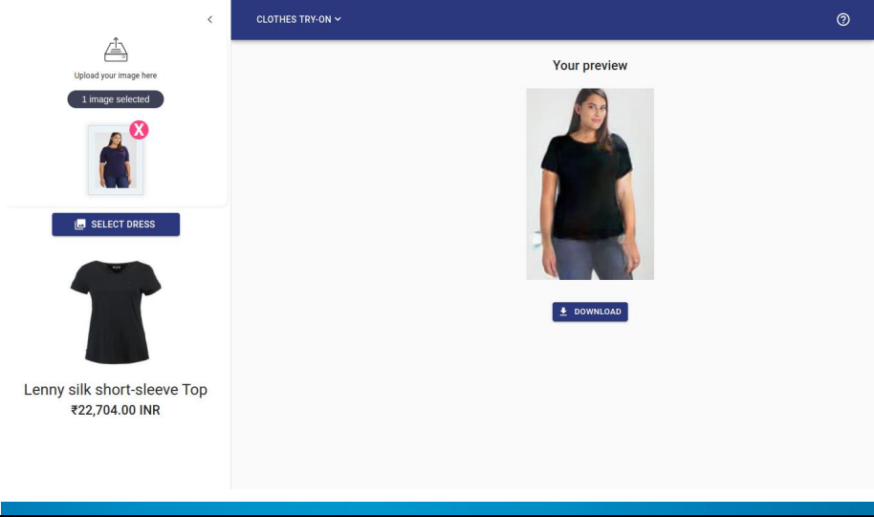
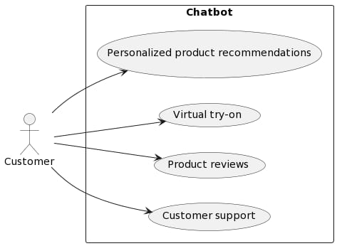
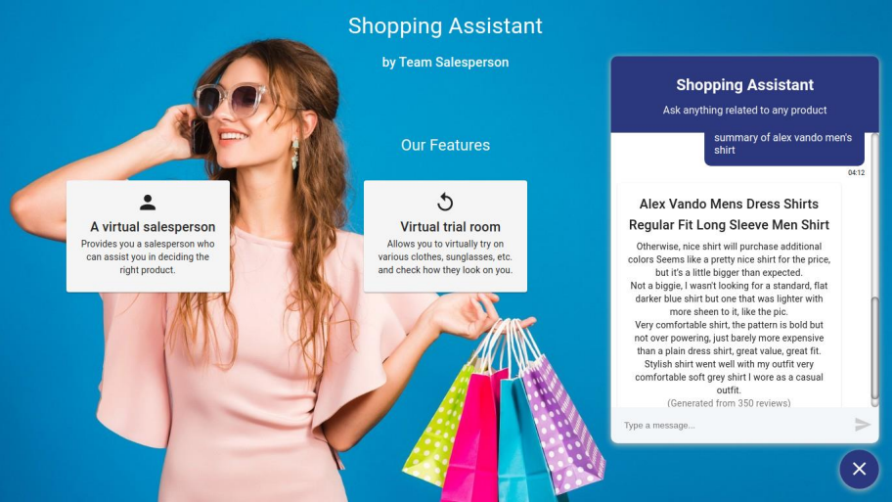
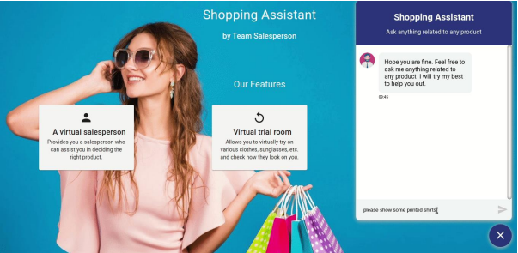
Online Shopping Assistant
Adrian Nzvimbo - Software Engineering Department
1.0 Abstract
3.0. Problem definition
6.0. System Overview
This project proposes the development of a chatbot that will assist customers in selecting the right products and bridge the gap between online and offline shopping. The chatbot will be equipped with features such as personalized recommendations, virtual try-on technology, and product reviews to improve the customer's shopping experience. The aim of this project is to reduce the risk of returns and increase customer satisfaction by providing customers with a more personalized and interactive shopping experience. The feasibility study considers the technical, economic, and operational aspects of the chatbot.If successful, this chatbot has the potential to revolutionize the ecommerce industry and transform the way
customers shop online.
The rise of ecommerce has led to an increase in online shopping, however, the inability of customers to physically touch and experience products before purchasing can lead to an unsatisfactory shopping experience. There is a gap between online and offline shopping that needs to be bridged. The main problem is that there is no salesperson available online to assist in deciding the right product for the consumer. Additionally, to get a good idea of a product, customers have to go through numerous reviews,
which can be time-consuming and tedious. Another major difficulty is the inability to judge how fashion products like clothing and sunglasses would look on them. To address these issues, a chatbot will bedeveloped that can suggest products to the consumer based on their needs, provide virtual try-on technology, and summarize product reviews. The chatbot aims to bridge the gap between online and offline shopping, reduce the risk of returns, and increase customer satisfaction by providing customers with a more personalized and interactive shopping experience
2.0. Introduction
Ecommerce has become an increasingly popular way for consumers to shop for products and services.With the rise of online shopping, businesses are looking for ways to provide their customers with a better shopping experience. One of the ways they are doing this is by using chatbots. The ecommerce industry has been experiencing explosive growth in recent years, with online sales expected to reach $4.9 trillion by 2021. As a result, many businesses have been investing in chatbots to automate routine tasks and enhance the customer experience. In fact, according to a study by Grand View Research, the global chatbot market size is expected to reach $1.23 billion by 2025, growing at a compound annual growth rate (CAGR) of 24.3% from 2020 to 20mnnjm25.
Chatbots are computer programs that are designed to simulate conversation with human users. They can be used to provide customer support, answer questions, and even complete transactions. In the context of ecommerce, chatbots are being used to provide customers with a more personalized and efficient shopping experience.The use of chatbots in ecommerce has several benefits. First, chatbots are available 24/7, which means that customers can get the support they need at any time of the day or night. This is particularly important for businesses that operate in different time zones or have customers in different parts of the world.
Second, chatbots are capable of handling a wide range of customer queries and requests. They can provide customers with product recommendations, help them find the products they’re looking for, and even complete transactions. This not only helps customers find what they’re looking for more quickly, but it also helps businesses increase their sales and revenue.Third, chatbots can provide businesses with valuable insights into their customers’ behavior and preferences. By analyzing customer data and purchase history, chatbots can provide businesses with information about what products are popular, what customers are looking for, and what they’re willing to pay. This information can be used to improve product offerings, pricing strategies, and marketing campaigns.
4.0. Overview of the developed application
7.0. Use Case Diagram
The proposed project involves the development of a chatbot that will assist customers in selecting the right products and bridge the gap between online and offline shopping. The chatbot will be equipped with personalized recommendations, virtual try-on technology, and product reviews to improve the customer's shopping experience. The objectives of the project are to provide personalized product recommendations to customers based on their needs and preferences, help customers virtually experience fashion products in real-time, and provide a summary of product reviews to help customers make informed decisions. The feasibility study considers the technical, economic, and operational aspects of the chatbot to ensure its success.
5.0. Objectives
Conclusion
The shop assistant chatbot has been designed to bridge the gap between online and offline shopping by providing personalized product recommendations, virtual try-on of fashion products, and summary of product reviews. The chatbot has been designed to provide a user-friendly experience to the customers and assist them in making informed decisions. The chatbot has been implemented and tested successfully and has shown promising results in terms of customer satisfaction and engagement.
To provide personalized product recommendations to customers based on their needs and
preferences
To help customers virtually experience fashion products, such as clothing and sunglasses, in realtime
To provide a summary of product reviews to help customers make informed decisions
8.0. Screenshots
Supervisor – L Amos

